Slide 1

Halved NN Function Prediction
April 2020
Yuval alfassi

Slide 2
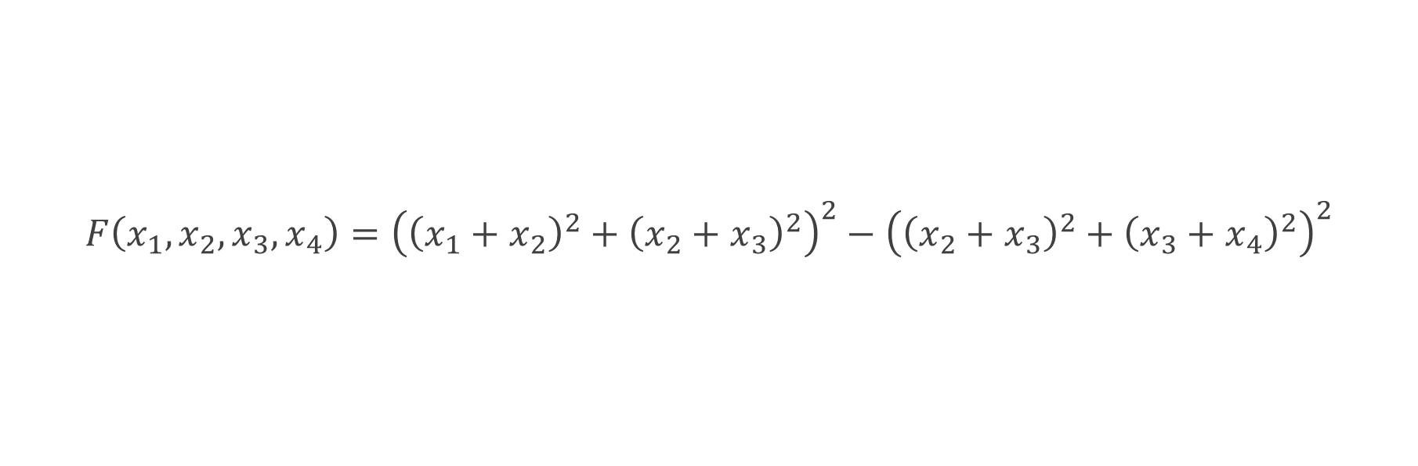
Predicted function
$$F\left(x_{1},x_{2},x_{3},x_{4}\right)={\left({\left(x_{1}+x_{2}\right)}^{2}+{\left(x_{2}+x_{3}\right)}^{2}\right)}^{2}−{\left({\left(x_{2}+x_{3}\right)}^{2}+{\left(x_{3}+x_{4}\right)}^{2}\right)}^{2}$$

Slide 3






NN Structure
$$x_{1}$$
NN1
$$x_{2}$$
$$x_{3}$$
$$x_{2}$$
NN2
$$x_{3}$$
$$x_{4}$$

Slide 4
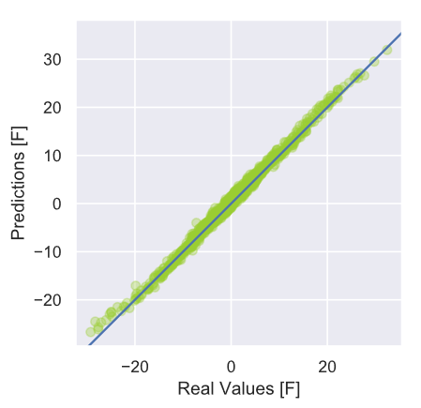
MSE = 0.5

Slide 5
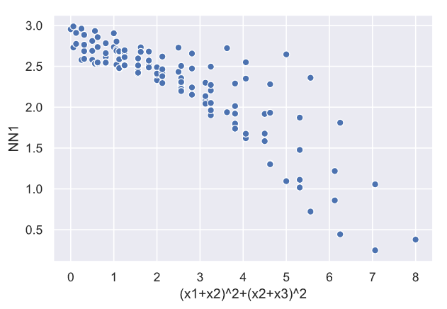
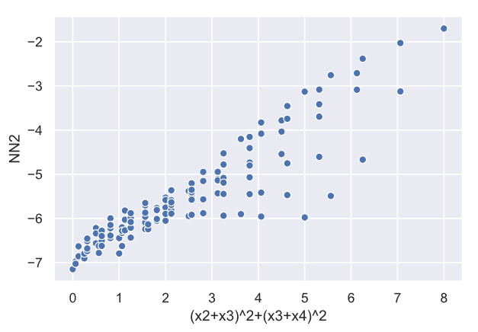
Nn1 & NN2 Predictions

Slide 6




Halving NN1
$$x_{1}$$
NN1_1
$$x_{2}$$
NN1
$$x_{2}$$
NN1_2
$$x_{3}$$

Slide 7
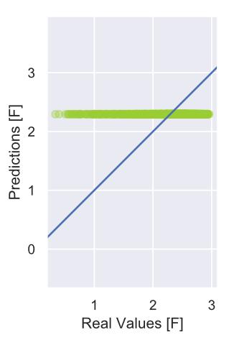
NN1: Does not converge

Slide 8
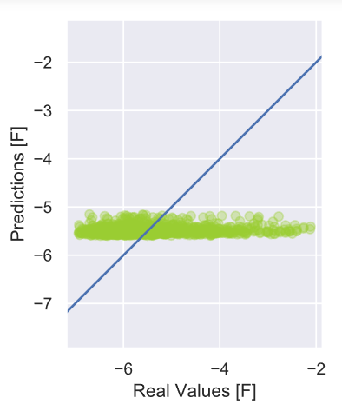
NN2: Does not converge

